Slide 1


SMART BIN-CONNECT
Bangalore Institute of Technology
K.R. Road, V V Puram, Bangalore-560004
Department of Electronics and Communication Engineering
MINI-PROJECT PRESENTATION
Under the guidance of:
Presented by
Dr VijayaLakshmi D
Associate Professor
Dept. of ECE
BIT.
Manju L 1BI23EC083
Manya V Bethur 1BI23EC085
Niriksha V Shetty 1BI23EC100
Pragathi P 1BI24EC410

Slide 2
ABSTRACT
We propose a smart waste management system using an ultrasonic sensor and GPS sensor interfaced with an Arduino to detect bin fill levels.
When a bin crosses the threshold, it automatically logs a complaint with GPS-based location on a municipal dashboard.
An Citizens can also report via three modes: voice input (speech-to-text with location extraction), photo upload (GPS metadata + user-selected status), or manual input (location + status).
Each report is stored with User ID, Location, Status, and Mode, giving authorities a clear dashboard to manage waste collection.
This hybrid, approach ensures faster response, reliable data, and active community engagement.
Bangalore Institute of Technology
Dept. of ECE, BIT

Slide 3
INTRODUCTION
This introduction presents an approach to improve urban cleanliness through the implementation of a Smart Waste Management System using arduino, ultrasonic sensors, and machine learning.
The system continually monitors bin fill levels with the ultrasonic sensor and sends real-time data with GPS location to a municipal dashboard.
It combines automated detection with citizen participation, where users can report issues via voice, photo, or manual input.
By incorporating ML for photo analysis, the system ensures accurate detection of bin status, enabling timely waste collection, reducing overflow, and enhancing community engagement.
Bangalore Institute of Technology
Dept. of ECE, BIT

Slide 4
OVERCOMING DRAWBACKS
Existing works in smart waste management have shown some progress:
Some projects used ultrasonic sensors to measure fill level.
Others connected bins via Arduino to send alerts.
But their limitations are :
Manual complaint registration is still required.
No AI-based auto-complaint generation.
Lack of user interaction flexibility.
No integration of voice or image recognition.
Our project overcomes these by:
Introducing AI that automatically raises complaints.
Allowing user interaction via NLP voice, ML image detection, and manual writing.
Providing a real-time centralized dashboard for both citizens and authorities.
Bangalore Institute of Technology
Dept. of ECE, BIT

Slide 5
APPLICATIONS
Smart Cities: Enhances municipal waste collection efficiency.
Urban Cleanliness: Prevents overflowing bins and reduces health risks.
Community Engagement: Citizens actively participate in reporting issues.
Resource Optimization: Ensures trucks are deployed only where needed.
Data-Driven Planning: Historical data helps improve waste collection strategies
Bangalore Institute of Technology
Dept. of ECE, BIT

Slide 6
LITERATURE SURVEY
SL.NO | TITLE | AUTHOR and PUBLICATION | ABOUT
1 | Innovative Waste Management: A Smart Complaint System | Published in IRJMETS 2025 (International Research Journal of Modernization in Engineering, Technology and Science) | Describes a smart waste complaint system where citizens can report issues via an automated platform. Features end-to-end complaint tracking and an authority dashboard, promoting efficient resolution and cleaner, more sustainable cities through digital solutions.
2 | Web-GIS based Framework for Solid Waste Complaint Management | Yadvendra Pratap Singh; A.K. Singh; R.P. Singh. Published as a ResearchGate article (original publication year: 2021) | Uses Web-GIS to track waste complaints with maps, location tagging, and automated authority reports.
3 |  | Menaka Pushpa Arthur, S. Shoba, Aru Pandey. Accepted: 19 Dec 2023 / Published Online: 15 Feb 2024. The Author(s) 2024 | Survey of Smart Dustbin Systems (SDS): Reviews IoT- and AI-based waste management, using deep learning for waste classification and monitoring. Compares datasets, notes system limitations, and highlights applications in universities, malls, and high-rises to reduce overflow, labor costs, and health risks
Survey of Smart Dustbin Systems Using the IoT and Deep Learning
Bangalore Institute of Technology
Dept. of ECE, BIT

Slide 7
OBJECTIVES
To automate complaint generation whenever a bin is filled, using IoT sensors and AI.
To provide location-based bin data with GPS integration.
To create a centralized dashboard for authorities to view complaints and take action.
To allow user participation through three modes – voice (NLP), image detection (ML), and manual writing.
To ensure scalability and efficiency in urban waste management.
Bangalore Institute of Technology
Dept. of ECE, BIT

Slide 8
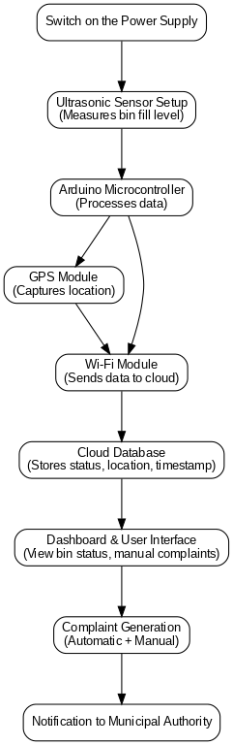
METHODOLOGY
Bangalore Institute of Technology
Dept. of ECE, BIT

Slide 9
METHODOLOGY
Our methodology has two parts:
Part 1 – Complete Automation:
The bin is equipped with sensors and a GPS module. Sensor data is sent to Arduino, which then transmits it to the web platform.
AI generates a complaint automatically when the bin is full.
This complaint is sent to the authority’s dashboard, visible to both users and officials.
Bangalore Institute of Technology
Dept. of ECE, BIT

Slide 10
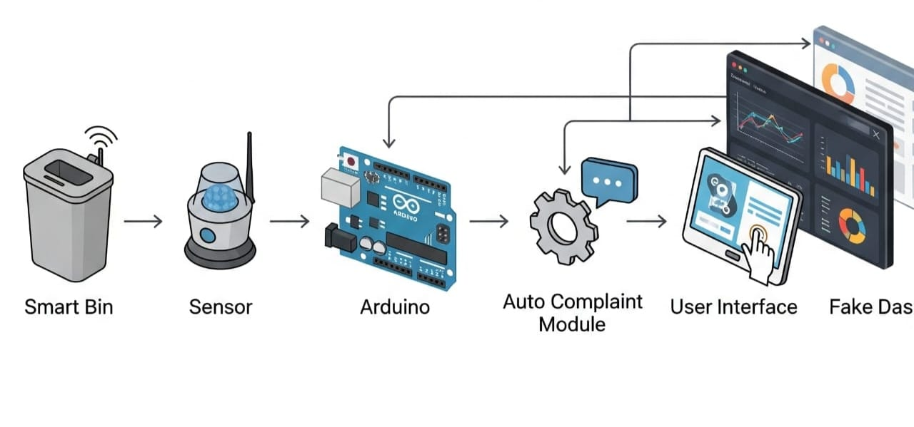
METHODOLOGY
Database
Database
Dashboard
SMART BIN - AUTOMATION
Bangalore Institute of Technology
Dept. of ECE, BIT

Slide 11
METHODOLOGY
Our methodology has two parts:
Part 2 – User Interaction (3 Modes):
Voice Input: Using Natural Language Processing, users can speak and register a complaint.
Image Input: Users upload a photo of the bin; our ML model detects if the bin is full.
Manual Input: Users can type and raise a complaint manually.
All three channels integrate into the same dashboard for authorities.
Bangalore Institute of Technology
Dept. of ECE, BIT

Slide 12
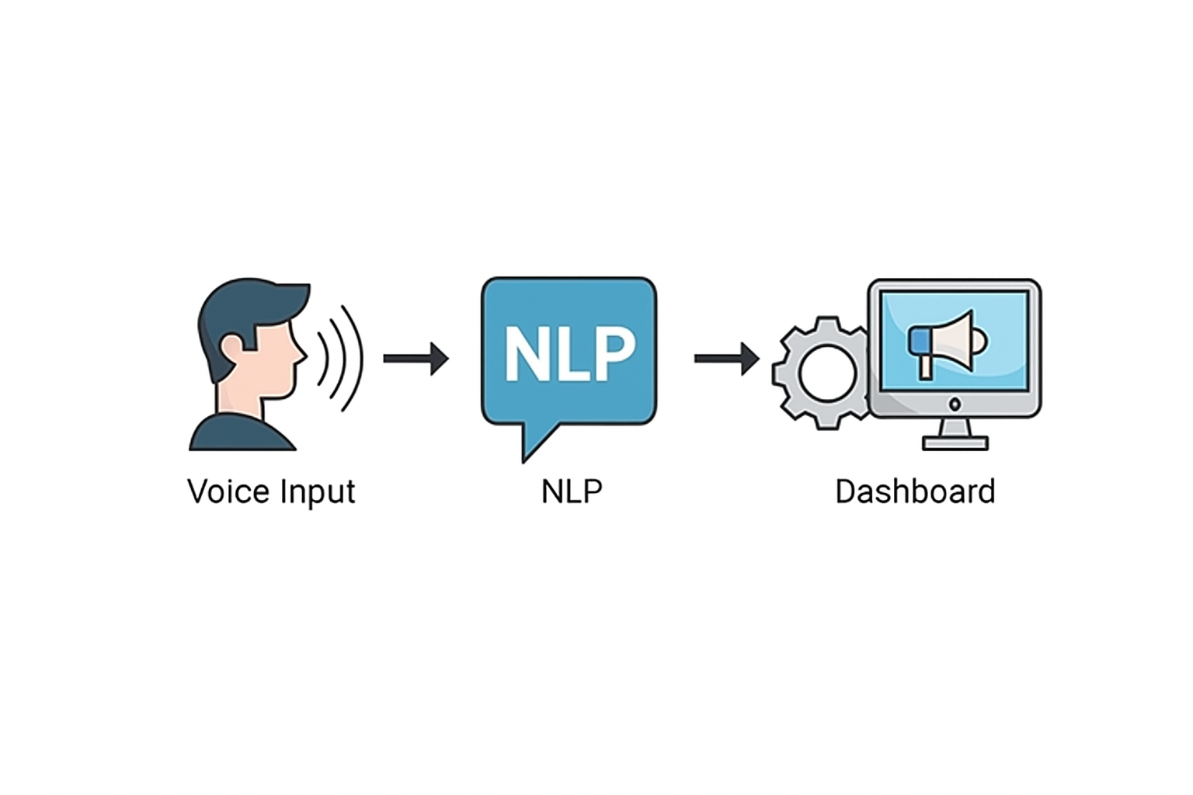

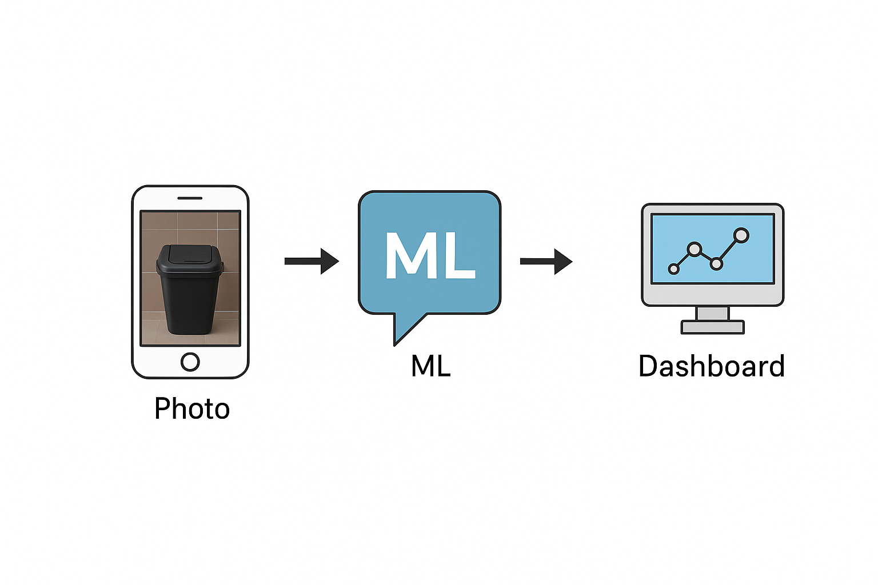
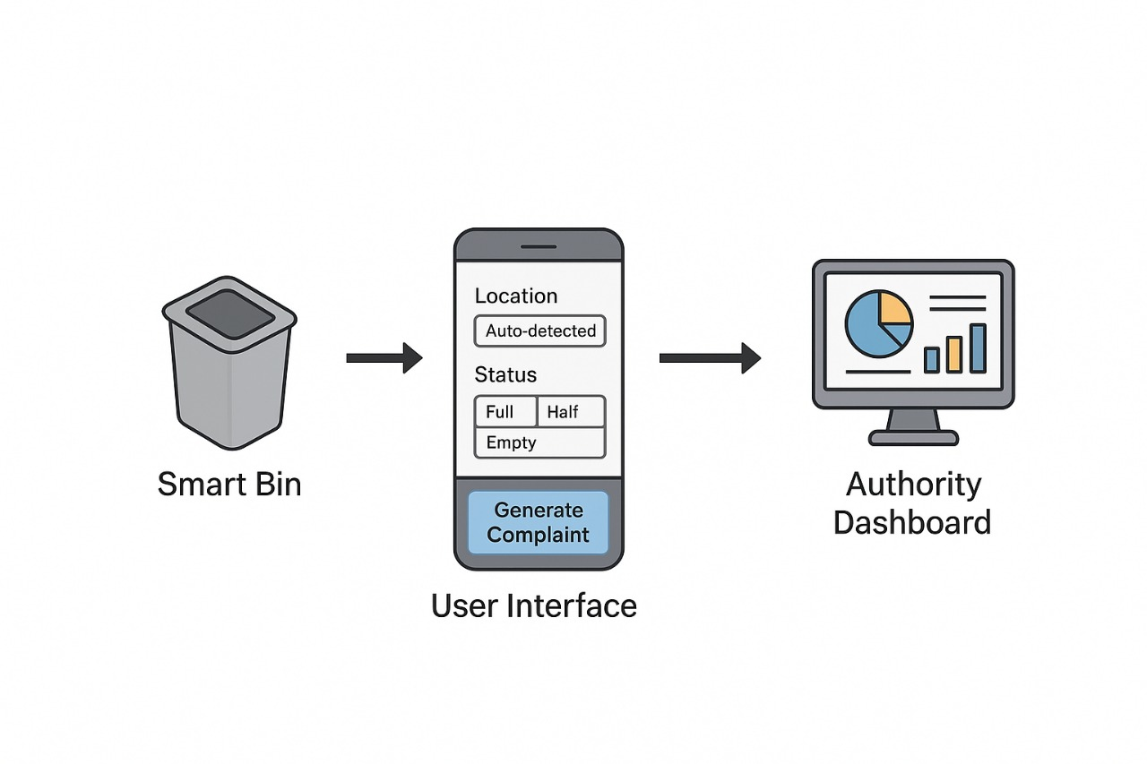
METHODOLOGY
Voice
Photo
USER
INTERACTION
Manual
Bangalore Institute of Technology
Dept. of ECE, BIT

Slide 13
COMPONENTS
HARDWARE COMPONENTS SOFTWARE COMPONENTS
Ultrasonic Sensor
Arduino UNO
GPS Module
Wi-Fi Module (ESP8266 )
Arduino IDE
Google Maps API
Web Dashboard
Backend Server (Node.js/PHP)
Database (MySQL)
Bangalore Institute of Technology
Dept. of ECE, BIT

Slide 14
EXPECTED RESULT
Accurate detection of waste bin fill levels in real time.
Automatic location tracking of waste bins through GPS.
Instant generation and logging of complaints on the dashboard.
Improved communication between waste management authorities and users.
Reduction in overflowing waste bins and improved public hygiene. Timely detection of full bins.
Bangalore Institute of Technology
Dept. of ECE, BIT

Slide 15
CONCLUSION
The proposed smart waste bin monitoring system integrates IoT technology to automate waste level detection, location tracking, and complaint generation.
By eliminating manual monitoring, the system ensures timely waste collection and improves cleanliness in public areas.
The use of GPS and online dashboards enables transparency and accessibility of waste status information.
The solution is cost-effective, scalable, and adaptable for urban smart city initiatives.
Ultimately, it bridges the gap between citizens, municipal authorities, and waste management systems for more efficient service delivery.
Bangalore Institute of Technology
Dept. of ECE, BIT

Slide 16

END
THANK YOU!
Bangalore Institute of Technology
Dept. of ECE, BIT

